Slide 1
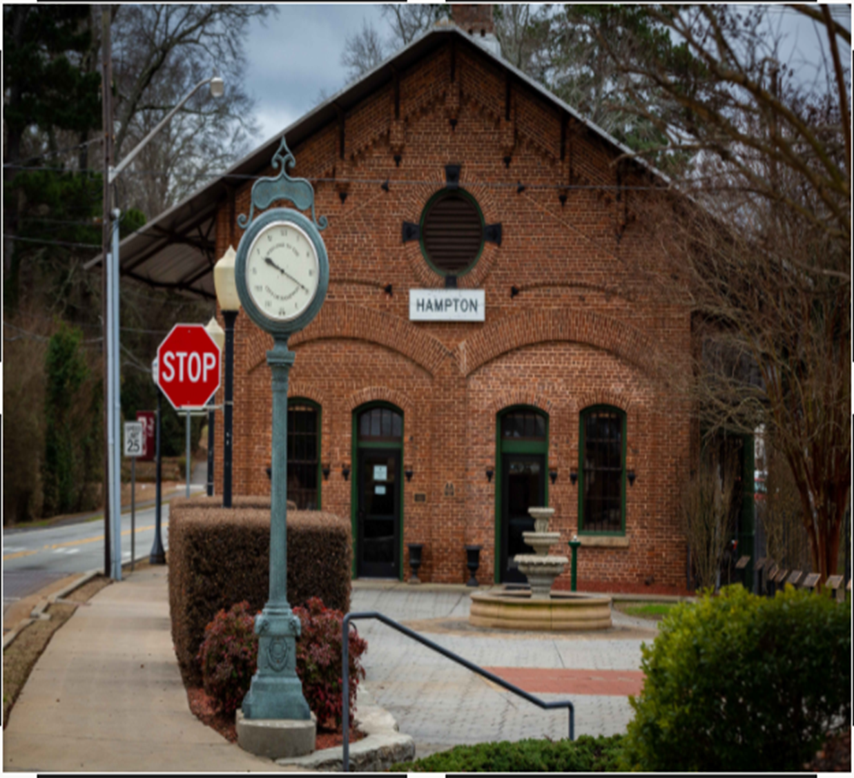

City of Hampton FY25 2ND Qtr. (Unaudited) Financial Results Mar.31st, 2025 Prepared by Finance Dept May 13th, 2025.

Slide 2

GENERAL FUND revenueS

Slide 3
GENERAL FUND expenditures

Slide 4
enterprise fund REVENUES

Slide 5
enterprise fund EXPENDITURES

